Slide 1
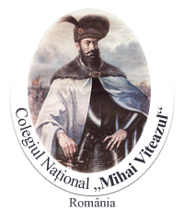
Mimar Sinan Lisesi

Slide 2
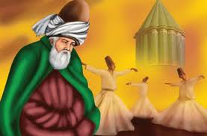
Come, come, come, whoever you are, heathen, or magi, Come again to be idolatrous, our convent, not despair, Come even if you broke your vows of repentance a hundred times ...

Slide 3
MEVLANA CELALEDDİN RUMİ
We want to give some information about sone Turkish famous people,for example Hacı Bektaşi Veli,Uruğ Bey,Ali Kuşçu,Farabi,İbn-i Sina,Hezarfen Ahmet Çelebi,Yunus Emre and Mimar Sinan.
We should mention that our school and many other schools took their names from this famous architect ‘Mimar Sinan’ Mimar means architect

Slide 4
Let’s start with Mevlana : who is Mevlana ?
Mevlana Celaleddin Rumi is a 13th century muslim saint and Anatolia mystic known throught the world for his fine poems and worlds of wisdom,Rumi as he is known in the west is the best selling poet in USA.
Also United Nations declared 2007 the year of Rumi and celebrations were held.
His doctrie advocates Unlimitted tolerance positive reasoning,goodness,charing and awareness through love.

Slide 5
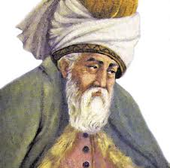
Mevlana
RÜKNEDDİN
HÜSEYİN HATİBİ
BAHAEDDİN VELED
MÜMİNE HATUN
MEVLANA – GEVHER HATUN
SULTAN VELED—ALAADDİN ÇELEBİ

Slide 6
Mevlana’s father was Bahaeddin Veled and mother was Mümine Hatun.Then Mevlana married Gevher Hatun and they had two sons named Sultan Veled and Alaeddin Çelebi to him all religions were more or less truth.Mevlana looked with the same eye on Muslim,jew and christian a like. In 1958 Pope John (XXIII) wrote a special message saying : in the name of the catholic world,I bow with respect before the memory of Rumi.

Slide 7
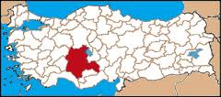
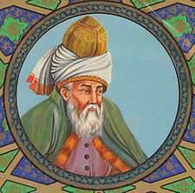

Slide 8
Whirlig dervishes sema : is a part of inspiration of Mevlana as well as of Turkish custom,history beliefs and culture. It is what we do as a form of rememberance of ‘GOD’
From a scientific viewpoint we witness that contemporary science definetely confirms that the fundamental condition of our existence is to rovelve.There is no object,no being which does not revolve and the shared similarity among beings is the revolution of the electrons,protons and neutrons in the atoms, which constitute the structure of each of them.

Slide 9
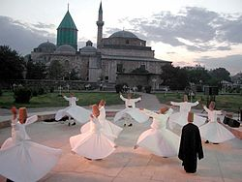

Slide 10
Whirling dervish “ or semazen causes the mind of participate in the shared similarity and revolution of all other beings… Otherwise, the Sema ceremony represents a mystical journey of man’s spiritual ascent thought mind and love to “Perferct”. Turning towards the truth, his growth throught love, desert his ego, find the truth and arrive to the “Perfect”, then he return from this spiritual journey as a man who reached maturity and greater perfection, so as to love and to be of servise to the whole of creation, to all creatures without discrimination of believes, races, classes and nations.

Slide 12
Books…
Mesnevi
Dîvân-ı Kebir
Mektûbât
Mecâlis-i Seb'a
Fîhi Mâ Fih

Slide 13
Mesnevi: In his books Hz. Mevlana talks about how to be a whole some huanbeing; one who has inner peaace and harmony, one is both aware of and appreciates GOD’s blessings, takes a stand in the face of life’s hardships and one who is tolerant and loving.

Slide 14
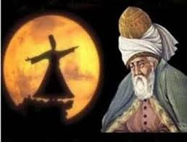
SEVEN ADVICE OF MEVLANA
1-In generosity and helping
others be like a river
2-In compassion and grace be like sun.
3- ın concealing others’ faults be like night
4-In anger and fury be like dead
5-In modesty and humility be like earth
6-In tolerance be like a sea
7-Either exist as you as
you are or be as you look

Slide 15
Mevlana, who summed up life in the above words died on 17 December 1273. As he reached out to his God and his beloved propled, that day called Seb-i Arus (wedding night) the night of unity. We would like to conclude our words with the following advice.
There is a life, search that life,
Search the secret jewel in the mountain of your body,
Hey you,the passing away friend,look for with all your strenght
Whatever you are looking for,look in yourself not around.

Slide 16
To sum up: Mevlana described his life :
Raw I was
Cooked well
Burnt I got

Slide 17
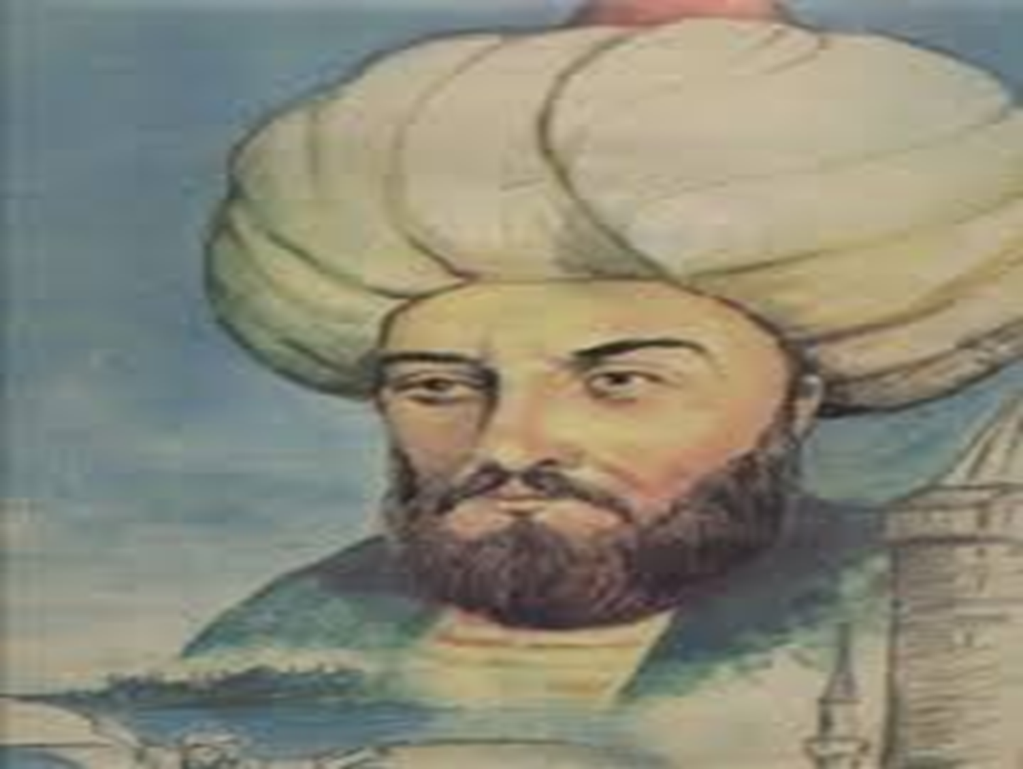
Hezarfen Ahmet Çelebi

Slide 18
HEZARFEN AHMET ÇELEBİ
Hezarfen Ahmet Çelebi he lived in istanbul in the 17th century during the Ottoman Empire.He made the first flight with artificial wings in the history of aviation.The event took place in the year 1638.
Hezarfen took off from the 183-foot tall Galata Tower near Bosporus and landed successfully at Üsküdar,on the other side.

Slide 19
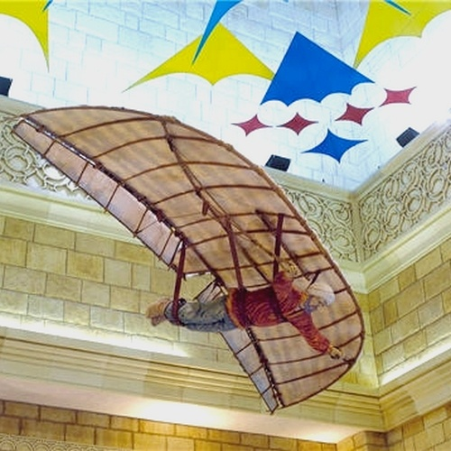

Slide 20
This feat was 200 years a head of its time.Hezarfen was awarded a thousand gold pieces.Unfortunsately,because of religious intolerance and political asinity.Sultan Murad exiled him to Algeria.
After two years Hezarfen died.He was thirty one.Hezarfen Ahmet Çelebi is an unforgettable name.

Slide 21
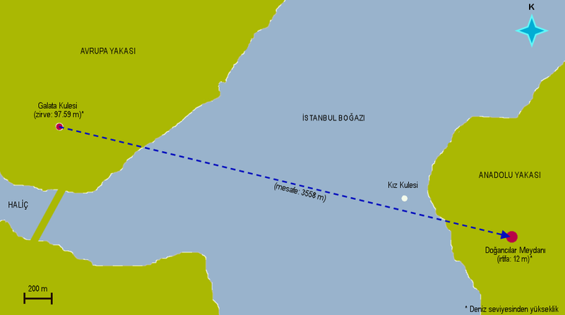

Slide 22
His trials and tribulations have the shadow of genius.
There is an airport called Hezarfen Ahmet Çelebi in İstanbul and it is a symbol that dreams don’t die.

Slide 23
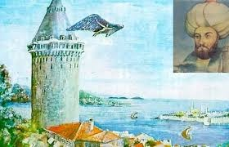

Slide 24
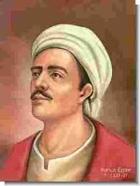
Yunus Emre

Slide 25
YUNUS EMRE
Yunus Emre (1240-1321) was a Turkish poet and Sufi mystic.He has exercised immense influence on Turkish literature,from his own day until the present.
His diction remains very close to the popular speech of his contemporaries in central and western Anatolia.

Slide 26
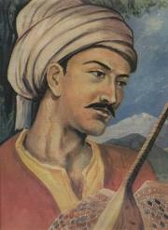
1238?–1320?

Slide 27
This is also the language of a number of anonymous folk-poets,folk-songs,fairy-tales
riddles and proverbs.
Following the Mongolian invasion of Anatolia.
İslamic mystic literature thrived in anatolia,and Yunus Emre become one of it is most distinguishe poets.

Slide 28
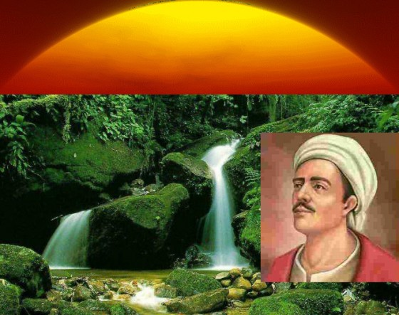
Come, let us all be friends for once, Let us make life easy on us, Let us be lovers and loved ones, The earth shall be left to no one.

Slide 29
We love the created For the Creator's sake

Slide 30
He is called poems of Sultan Yunus Emre despite being fairly simple on the surface-evidence his talent describing quite abstruse mystical concepts in a clear way.
He remains a popular figure in a number of countries,from Azerbaijan to the Balkans.

Slide 31
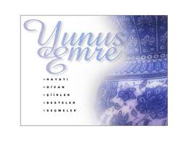

Slide 32
Burning, burning, I drift and tread love spattered my body with blood I'm not in my senses nor mad come, see what love has done to me Read more at
I'm Yunus mystic of sorrow suffering wounds from top to toe in the friend' s hands I wrtihe in woe come, see what love has done to me

Slide 33
Thank you for listening to us

